Slide 1
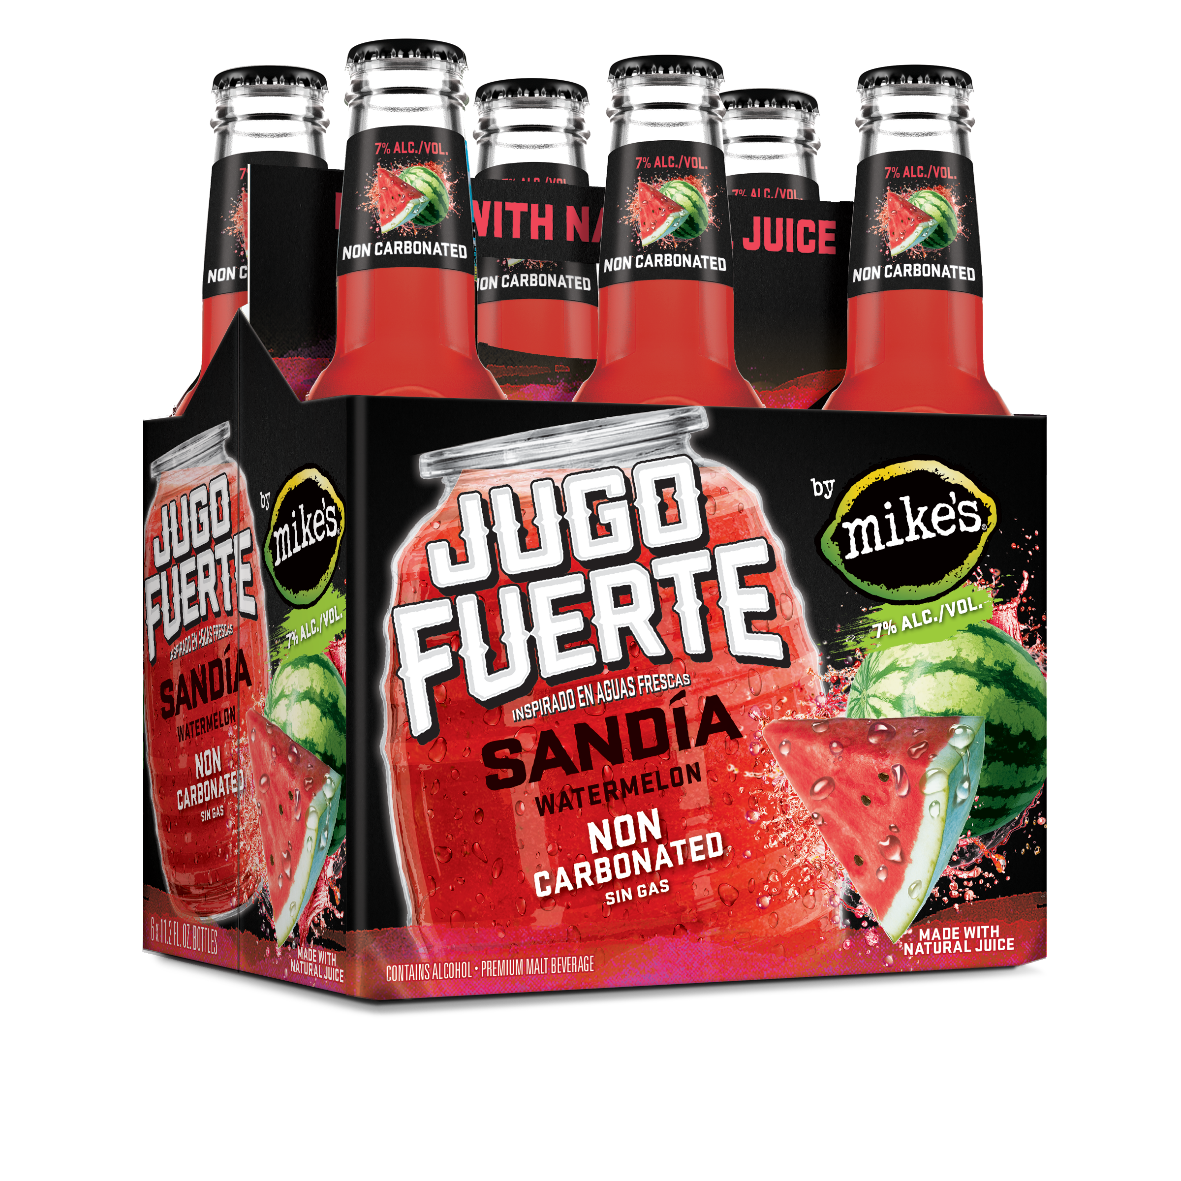
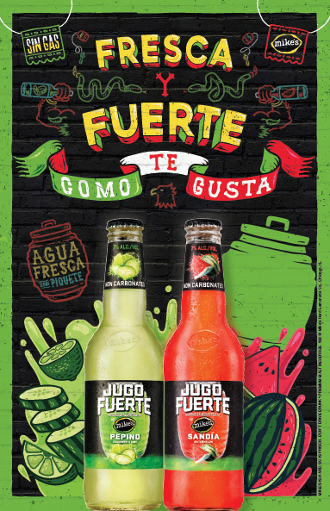
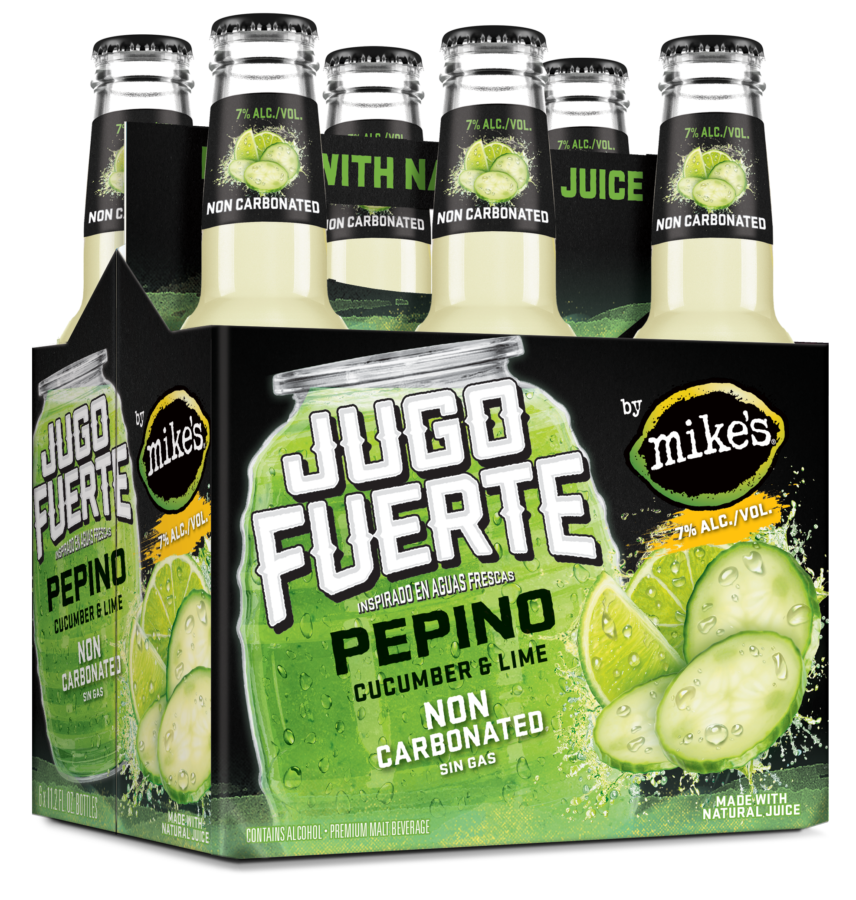
Jugo Fuerte by mike’s!
7% ABV drives appeal, particularly amongst men
Draws permission & credibility
from mike’s brand
Dual language on-pack creates affinity with Latino consumer
Fruit imagery creates strong
taste appeal

Slide 2
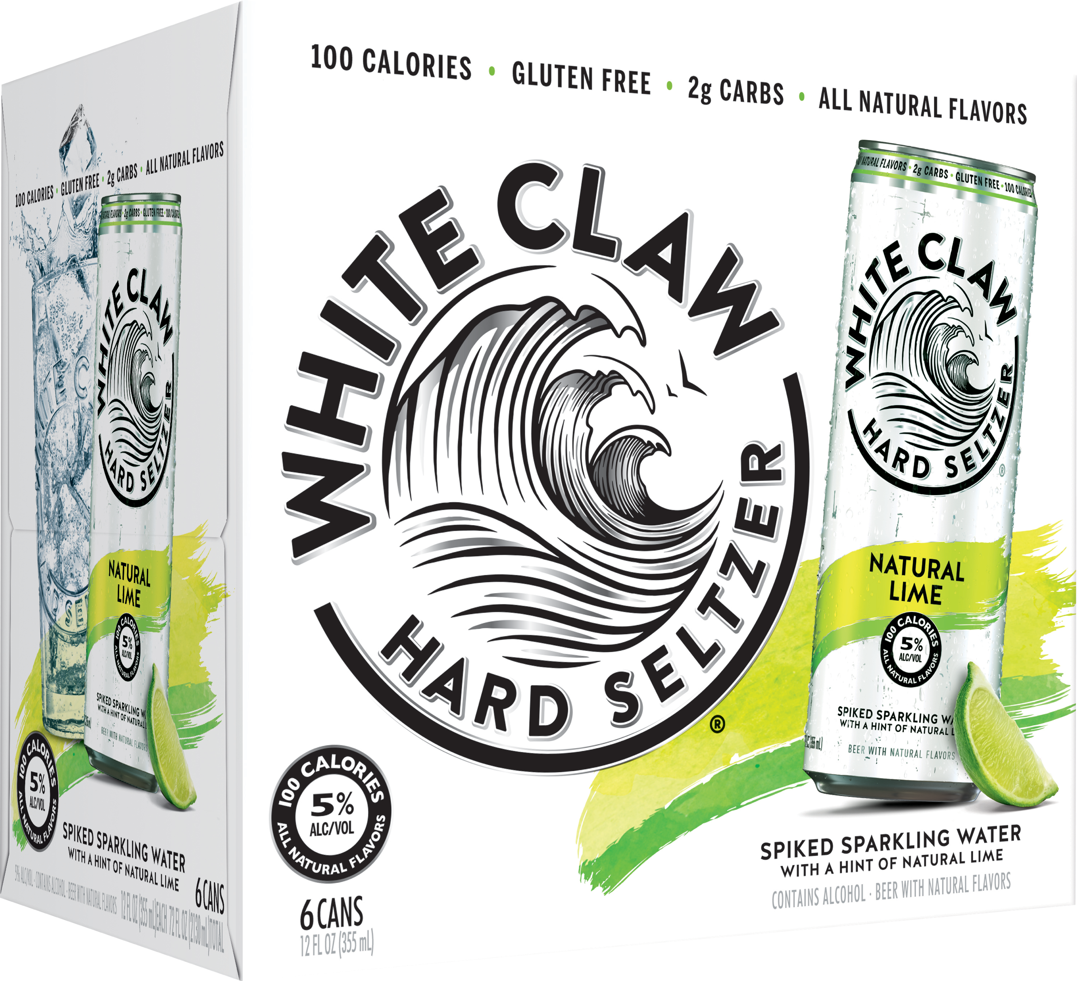
Jugo Fuerte Outperformed Seltzers with Hispanic Consumers
Average Weekly Units Per Pt ACV Dist.
Phoenix: +75%
DFW: +45%
IRI, MULO-C – DFW & Phoenix – April-May 2018

Slide 3
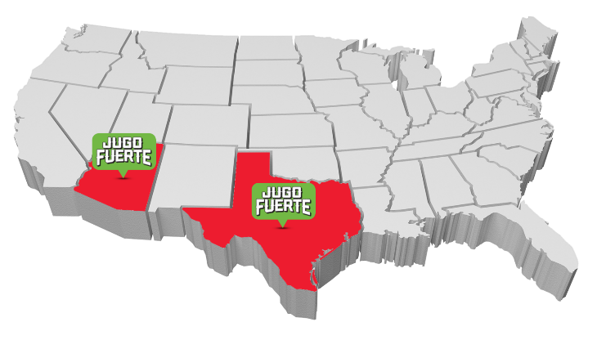
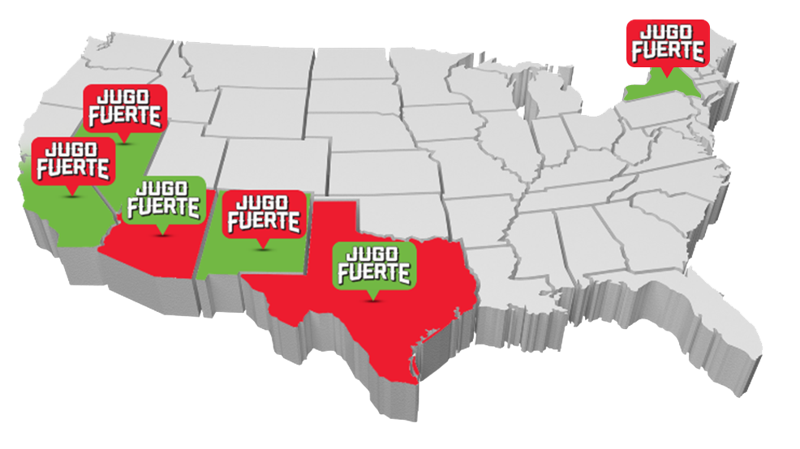
Jugo Fuerte Markets
Notes:
Nevada, California, New Jersey & New Mexico – GREEN states with RED flags, RED COMES in first, GREEN second

Slide 4
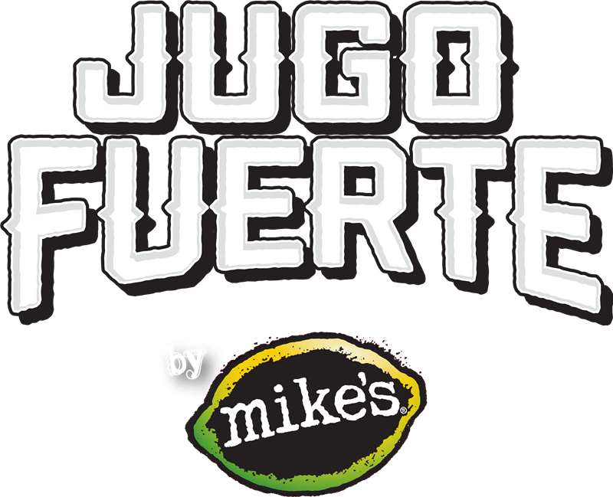
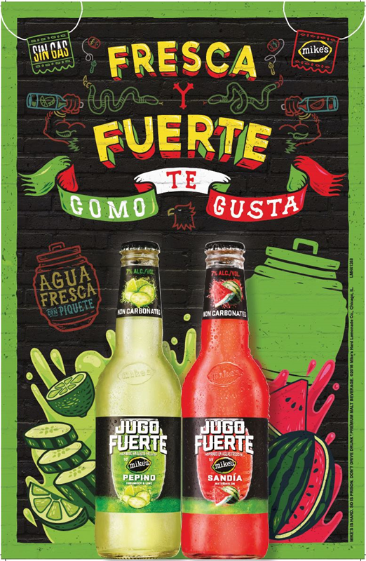
mike’s supports Jugo Fuerte
Over $1M in Media Investments & Sampling
14 Focus Markets
Digital Media
Social Media
POS & Displays
Notes:
NEW facts from SANDRA

